Slide 1

LAPTOP PRICE PREDICTION
Presented by Pranav G Nair

Slide 2
PROBLEM STATEMENT
The problem statement is that if any user wants to buy a laptop then our model should be compatible to provide a tentative price of laptop according to the user configurations. Although it looks like a simple project or just developing a model, the dataset we have is noisy and needs lots of feature engineering, and preprocessing.

Slide 3



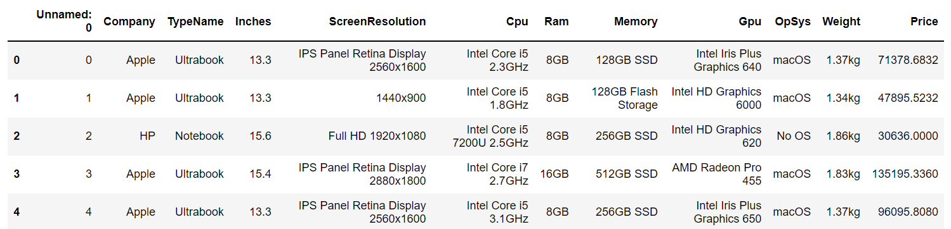
DATA SET INFORMATION
Will split the data for training and testing
85% Training data
15% Testing data.
Dataset is collected from Kaggle which contains details of various laptops.
The size of the dataset is 1303 rows*12 columns.

Slide 4
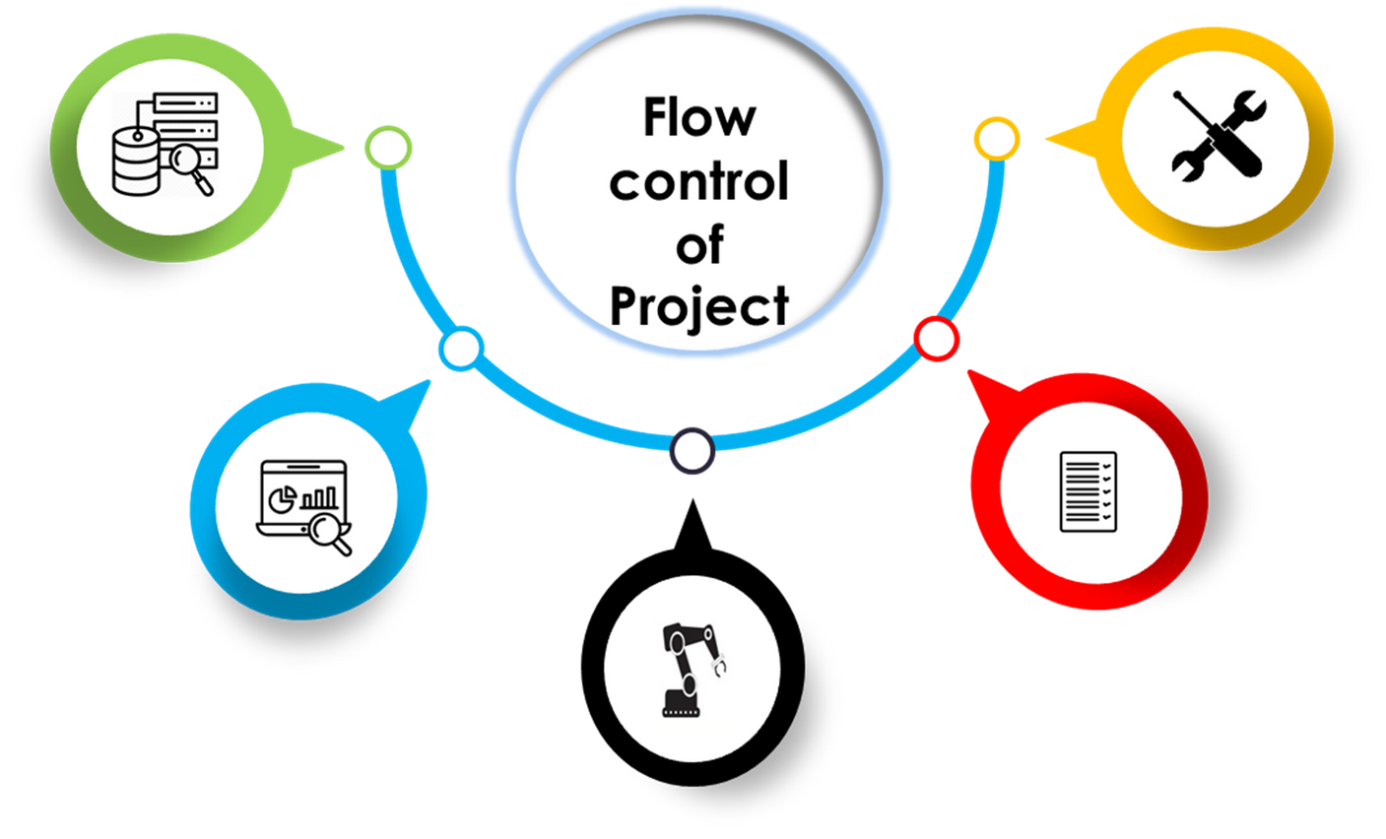
Data Collection
Data is collected from data sources.
Enhancing Performance:
The performance of model is improved by again refining the data and building the model again.
Exploratory Data Analysis:
The Data is being investigated and appropriate Feature Engineering is done.
Performance Testing:
After creating the model the performance of model is being tested by test data. The performance is analyzed using R2 Score and Mean Absolute Error.
Regressor Model:
The data is trained and model is created.

Slide 5
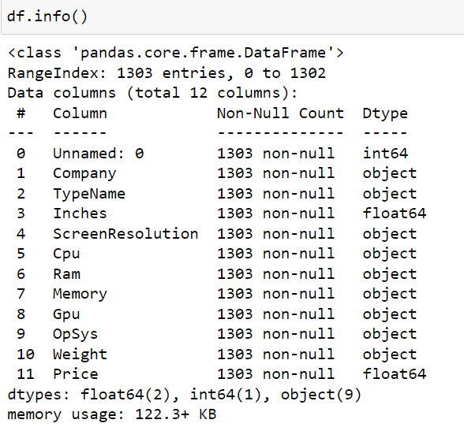
FEATURES INVOLED
THE FEATURES INVOLVED IN OUR DATASET ARE:
Company
Type Name
Inches
Screen Resolution
CPU
RAM
Memory
GPU
Operating System
Weight
OUR TARGET VARIABLE IS PRICE

Slide 6
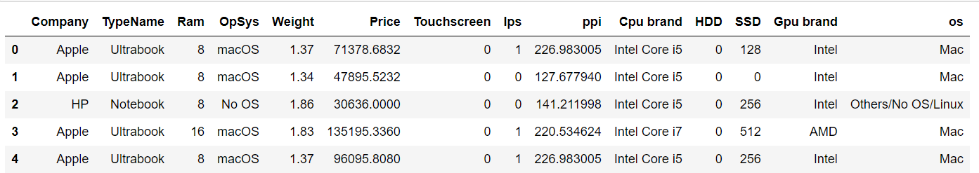
FEATURES ENGINEERING
There is lot of important data hidden among these columns which are not in a structured and clean manner.
A lot of Feature Engineering is required to extract there important information from the columns in the dataset.
Our final dataset after EDA and Feature Engineering would be as below:

Slide 7
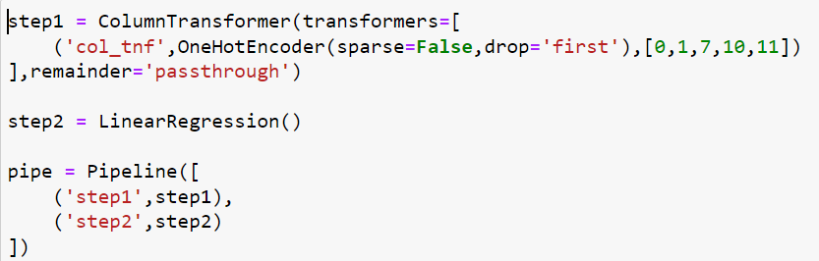
Pipeline Creation And Model Building Using Machine Learning Algorithms
WE CREATE PIPELINES WITH TWO STEPS AND BUILD THE MODEL USING DIFFERENT MACHINE LEARNING REGRESSION ALGORITHMS SUCH AS:
Linear
Ridge
Lasso
KNN
Decision Tree
SVM
Random Forest
AdaBoost
Gradient Boost
Xg Boost
← PIPELINE CREATION

Slide 8
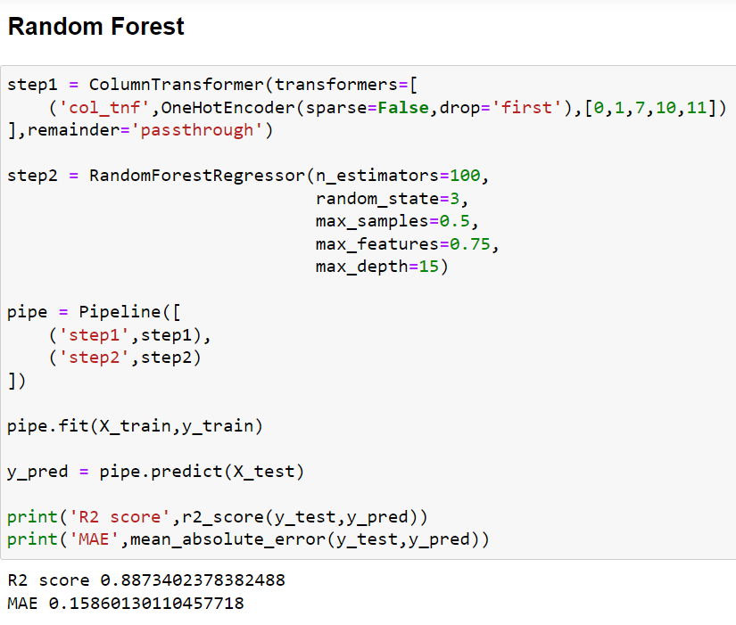
PERFORMANCE OF THE MODEL
WE GET THE BEST R2 SCORE AND MEAN ABSOLUTE ERROR WITH RANDOM FOREST AS SHOWN BELOW:
R2 score of 0.887 and MAE of 0.158 with Random Forest which is slightly better than other models.

Slide 9
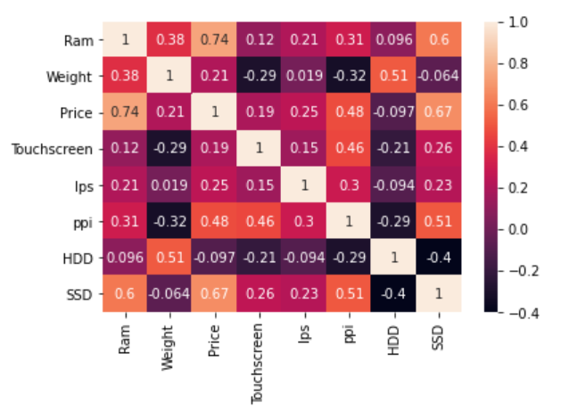
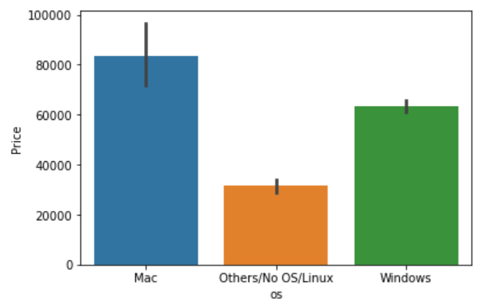
KEY FINDINGS
The price of the laptop very much depends linearly on the RAM and the presence of SSD.
The price of Mac OS Laptops are the highest followed by Windows OS and finally by Other OS.

Slide 10
HOW IS IT HELPFUL FOR THE BUSINESS?
If in the case where the Buyer is specific about his requirements but not sure about the price it would cost him/her for his requirements, this model would help the buyer to find exactly that.
This model helps the sellers to recommend the right laptop to the buyers and hence leads to better Customer Satisfaction.

Slide 11
THANK YOU
PERSONAL INFO Name: Pranav G Nair Mobile: 9035453100 Email: pranavgnair2012@gmail.com

